Slide 1

Group 3
Evelyne De Man
Febe Moens
Joran Vergauwen
Heleen Vanelverdinghe
Notes:
Evelyne

Slide 2
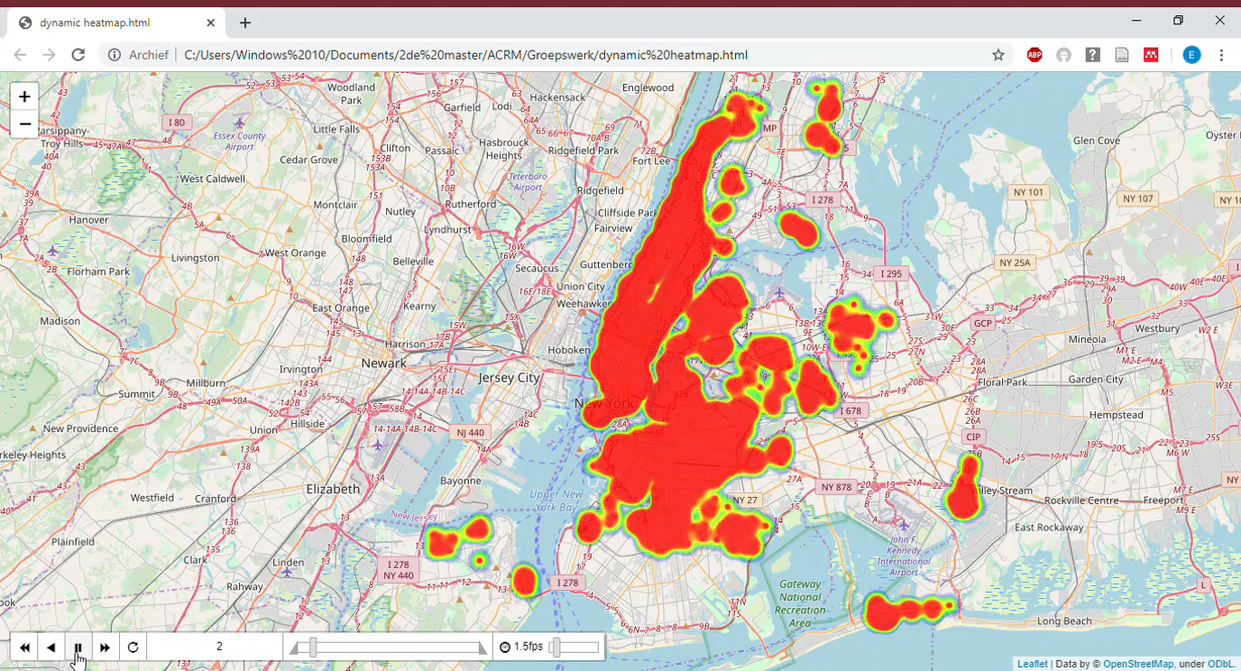
Notes:
Evelyne

Slide 3
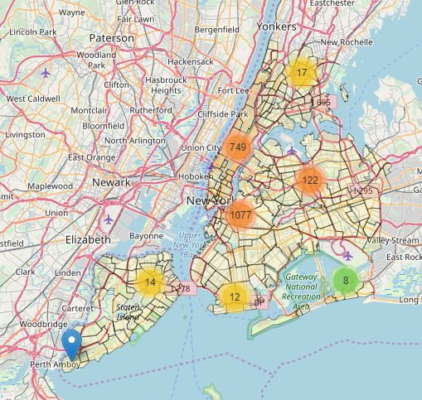
Overview
Price Analysis
Host & room types
Reviews
Notes:
Evelyne

Slide 4
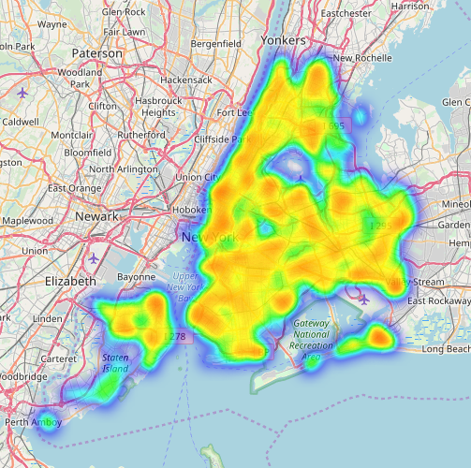
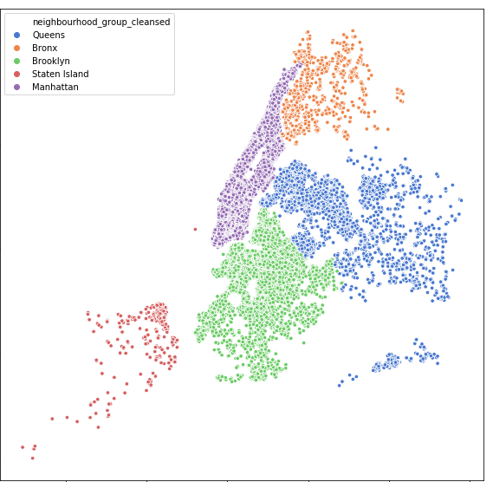
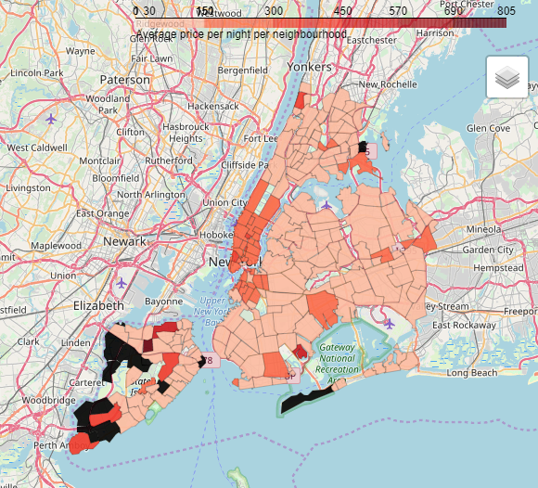
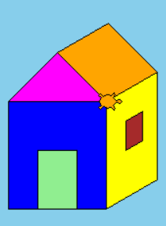
Price analysis
Notes:
Evelyne

Slide 5
Entire City
Notes:
Evelyne

Slide 6
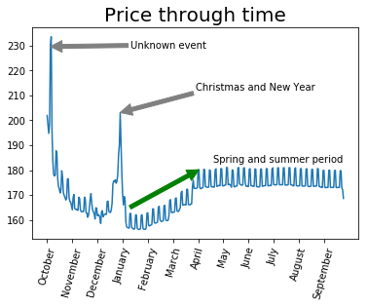
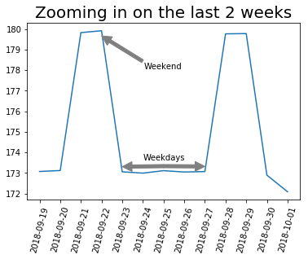
Price evolution
Notes:
Evelyne

Slide 7
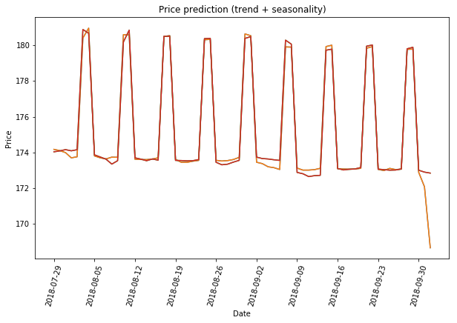
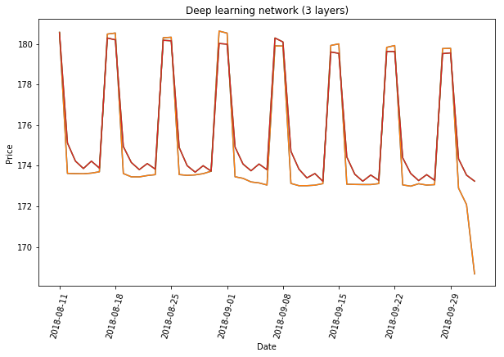
Price prediction
Trend line and seasonality
Deep learning network
MAE = 0.2335
MAE = 0.6397
MAE = 0.2335
Notes:
Joran

Slide 8
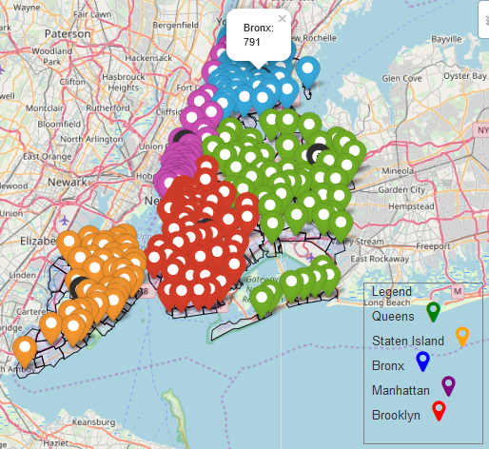
Neighborhood groups
Notes:
Heleen

Slide 9
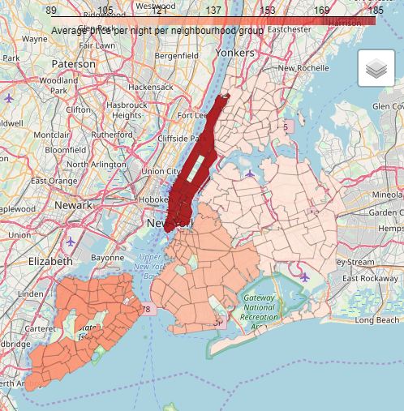
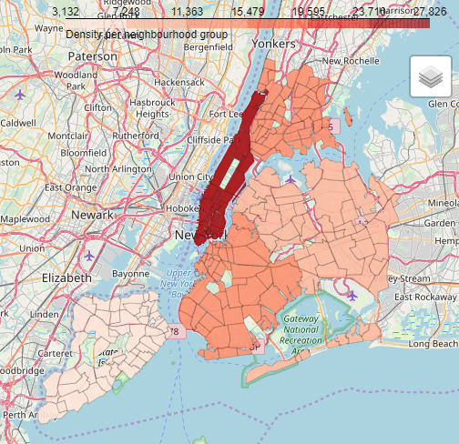
Listing price and population density are correlated
Notes:
Heleen
Q6
per neighbourhood of per neighbourhood group (nog demographics zoeken)

Slide 10
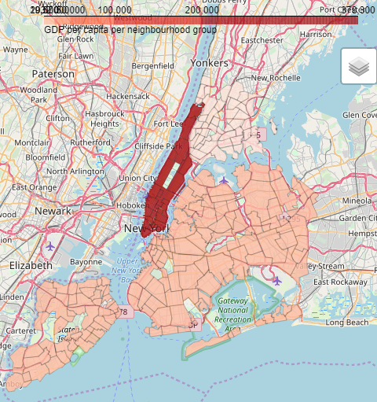
Listing price and gdp per capita are correlated
Notes:
Heleen
Q6
per neighbourhood of per neighbourhood group (nog demographics zoeken)

Slide 11
Neighborhoods
Notes:
Heleen

Slide 12
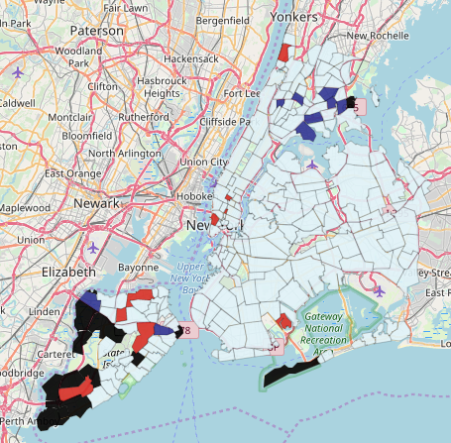
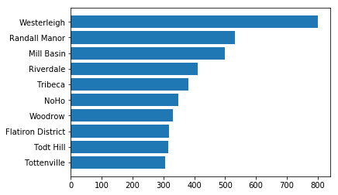
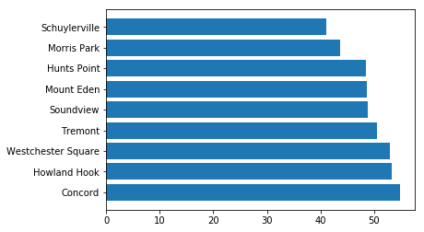
10 cheapest and 10 most expensive listings
Notes:
Heleen

Slide 13
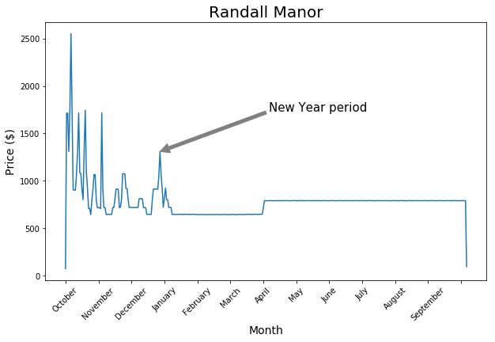
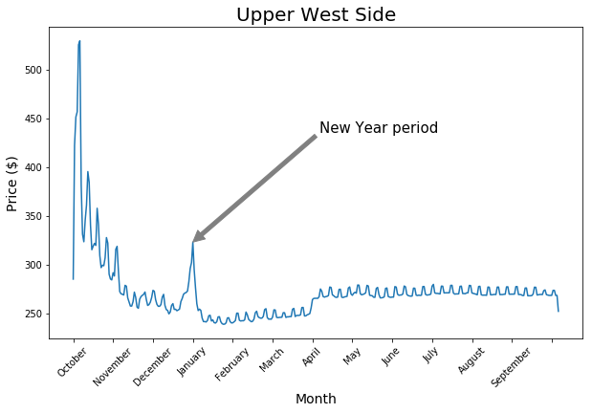
New year price jump
Notes:
Heleen
meerdere neighbourhoods tonen (met grootste variantie)
Randall Manor (meest onregelmatig) Jamaica Sea Gate Riverdale
spike in het begin over heel new york → ook te zien per neighbourhood eind december en januari → geen daling maar blijft hoog november : Thanksgiving

Slide 14
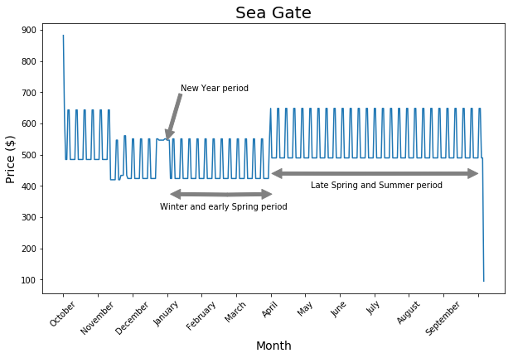
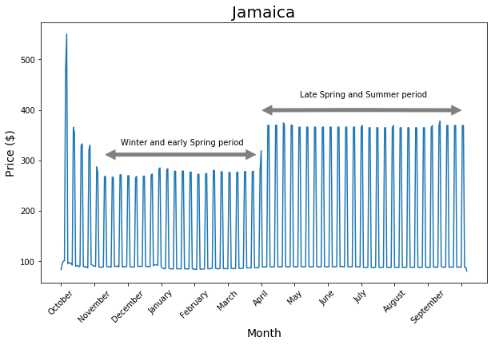
Price ‘Summer sault’
Notes:
Heleen

Slide 15
listing
Notes:
Joran

Slide 16
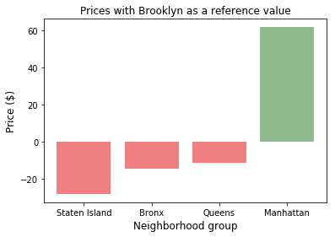
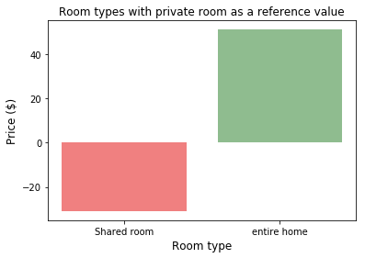
What factors drive the price of a listing?
Notes:
Joran
Linear regression op een interessante manier tonen
benchmark: private room in manhattan
neighbourhood group (wijze visual)
pay for extra people (30 dollar goedkoper als je moet bijbetalen)
instant bookable (8 dollar goedkoper, mss minder kwaliteitsvol?)
(vraag 8 ook eventjes vermelden, geprobeerd maar niet significant)
verdergaan met prediction algoritme van Joran EXTRA prototype: als iemand nieuwe airbnb wilt openen, we kunnen price range geven (in volle ontwikkeling) + na een tijdje kunnen ze prijs optimaliseren door schatting, backfitting

Slide 17




What factors drive the price of a listing?
Number of accommodates
+$31
Instant bookable
-$14.28
Number of accommodates
-$37.43
Distance from Manhattan Bridge
-$6.35
Notes:
Joran
Linear regression op een interessante manier tonen
benchmark: private room in manhattan
neighbourhood group (wijze visual)
pay for extra people (30 dollar goedkoper als je moet bijbetalen)
instant bookable (8 dollar goedkoper, mss minder kwaliteitsvol?)
(vraag 8 ook eventjes vermelden, geprobeerd maar niet significant)
verdergaan met prediction algoritme van Joran EXTRA prototype: als iemand nieuwe airbnb wilt openen, we kunnen price range geven (in volle ontwikkeling) + na een tijdje kunnen ze prijs optimaliseren door schatting, backfitting

Slide 18
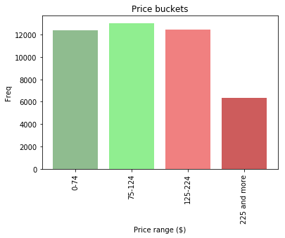
Price suggestions
Prototype
Price suggestions for new listings
Advice when listing overpriced or underpriced
Notes:
Joran

Slide 19
HOSTS & room types
Notes:
Febe
Now let’s talk a bit more about the hosts

Slide 20
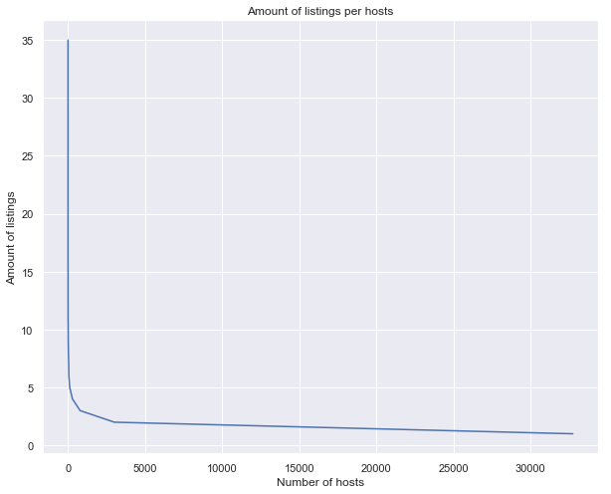
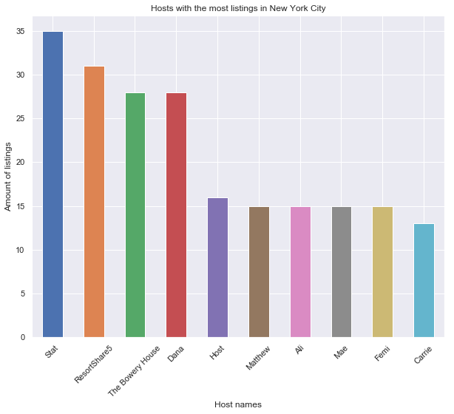
AMOUNT OF LISTINGS
95% of the hosts have less than 4 listings
Top three are firms that own many listings
Notes:
Febe
The amount of listigns that every host has can be represented by a long tail graph. We can conclude that there are very few hosts have more than 4 to 5 listings. We can say that about 95% have less than 4 listings.
Interesting as well is that 99% of the hosts that have more than one listing stay within the same neighborhood.
If we would zoom in at the top 10 hosts with the most amount of listings, we get this graph.
The maximum amount of listings is 35. But it we look at the names of the hosts of these top 3 (for example over here we have ‘resortshare5’) then we see that those are probable not individual people, but already some some sort of firm
Q11
globale info
eerst long tail en dan inzoomen op de tien hosts met de meeste
grafiek, hosts with most listings (The Bowery House = hotel, Resort share → zijn bedrijven met meerdere listings) 95% heeft minder dan 4 listings
blijven de 10 personen met de meeste listings in dezelfde neighbourhood?
Q12: 37100 listings in total, 99% stays in the same neighbourhood(36714), 1% has listings in different neigbhourhoods(386) -> samen met map?? vraag 18

Slide 21
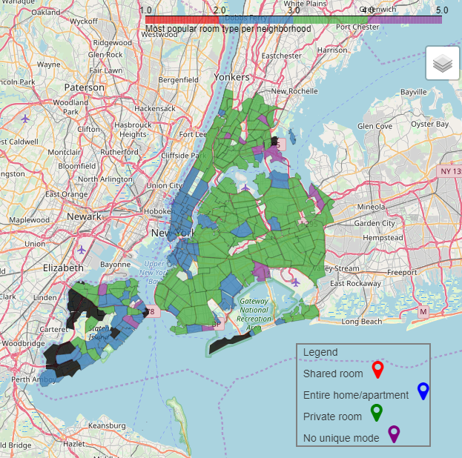
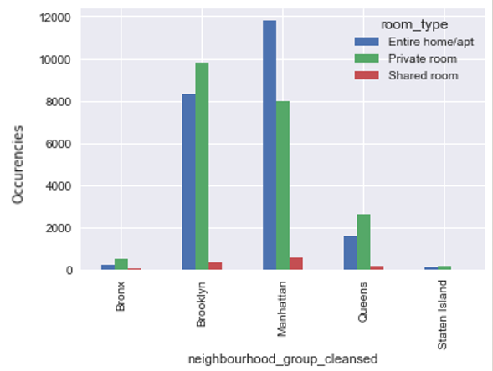
Most popular room type
Room types
Notes:
Next we heve some data about the different room types.
Mostly
We see that shared room (or red) is almost not listed in New York. More used is the entire home or ppartment(which is in blue om this map, so escpecially Manhattan) and the private room Is common (which is the green color, so Brookly, Queens and Bronx

Slide 22
REVIEWS
Notes:
Now let’s talk a bit about the reviews that the listings get.

Slide 23
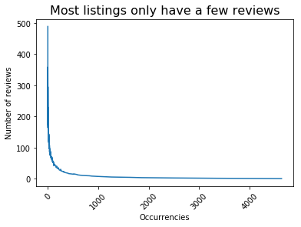
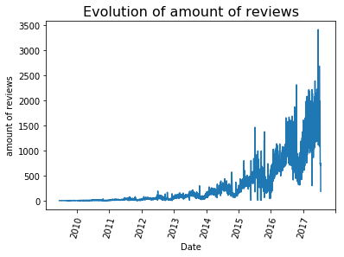
Review ‘long tail'
Amount of reviews

Slide 24
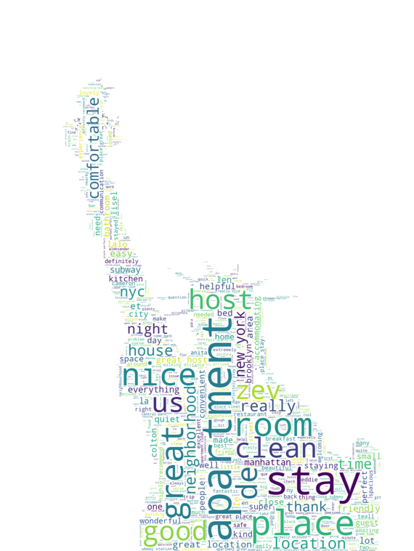
Notes:
Febe
If we would look at the most used words in reviews, we do see a lot of positivity!

